Slide 1
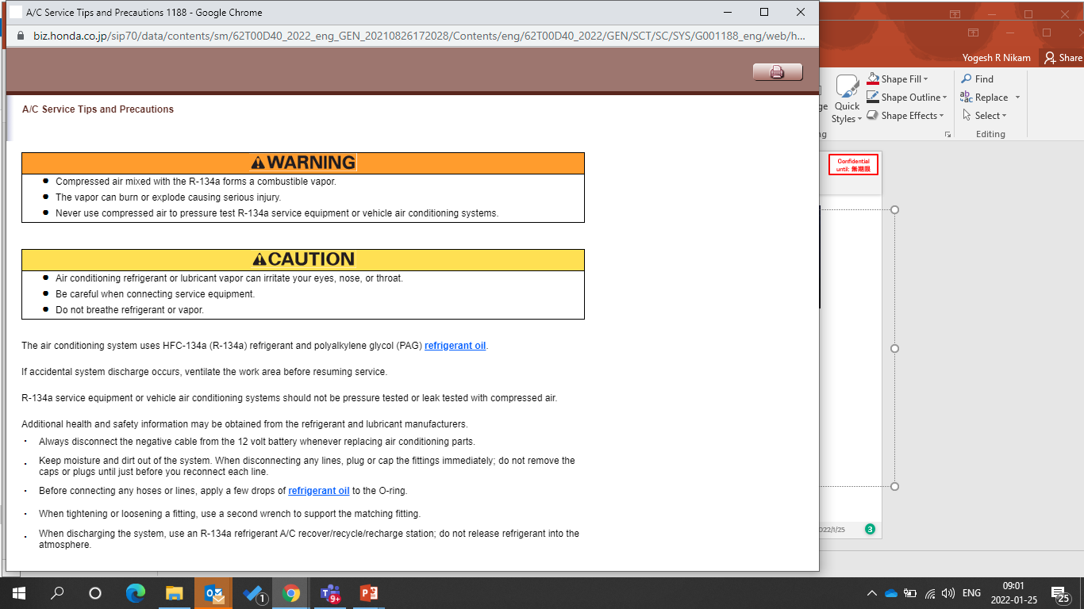
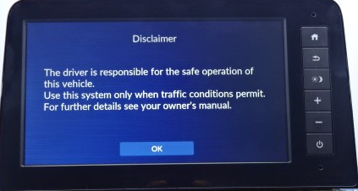
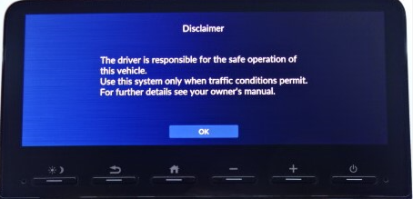
ANNEXURE- 1
Title : Identification of 8-inch & 10.25-inch DA Unit
Check visually system to identify Buttons of 8-inch unit are on the right side and buttons of 10.25-inch unit are on the bottom side.
Software for 8-inch and 10.25-inch DA are different. Select Software for installation basis physical unit in car
8-inch DA Unit
10.25-inch DA Unit

Slide 2
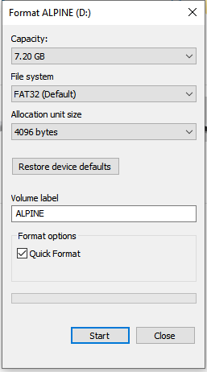
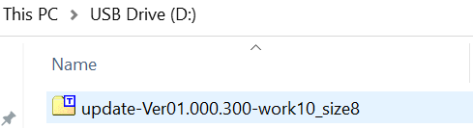
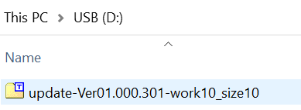
ANNEXURE- 2
Title : Preparation of the USB
Download the software files from below link.
  8-inch DA file name : update-Ver01.000.200-work10_size8
  10.25-inch DA file name : update-Ver01.000.201-work10_size10 2
software files from zip folder.
Format the USB as
  File system : FAT32
  Allocation Size : 4096 bytes
Transfer the relevant software files to USB device. USB device should not contain any other files.
8-inch DA Unit
10.25-inch DA Unit

Slide 3
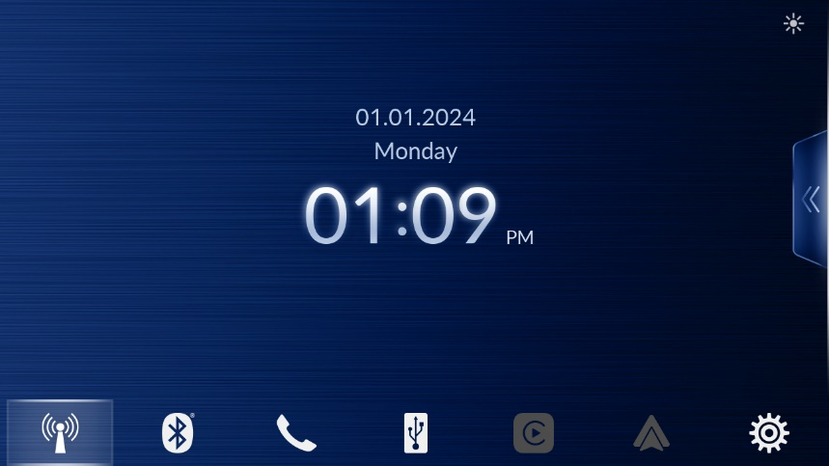

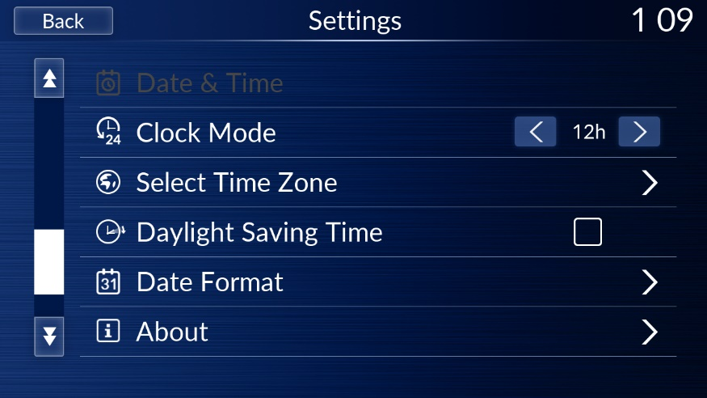
ANNEXURE- 3
Title : Software Version Check procedure
No. | Description | Details
1 | Switch on the ignition
2 | Select ‘Ok’ from caution screen
3 | Press ‘Setting’ button Flick screen to left
4 | Select the “About”.

Slide 4
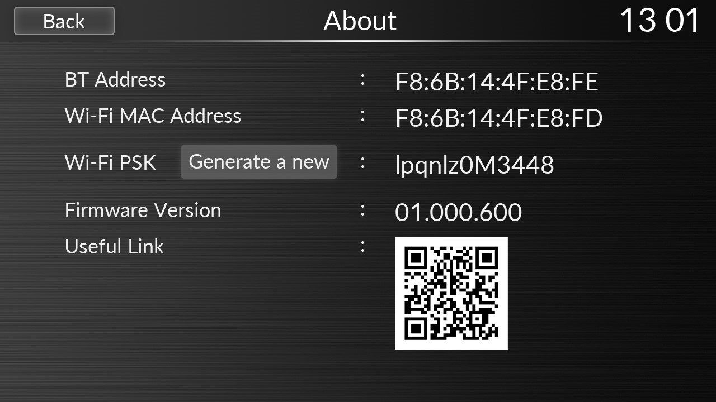
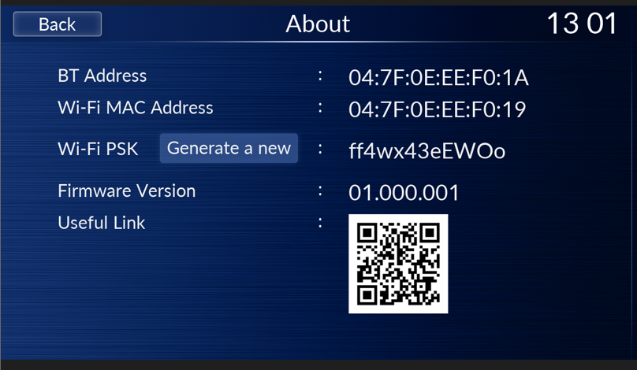
ANNEXURE- 3
Title : Software Version Check procedure
No. | Description | Details
5 | Observe “SYSTEM Version”
7 | Observe “SYSTEM Version”

Slide 5

ANNEXURE- 3
Title : Software Version Check procedure
No. | Description | Details
8 | Updated “SYSTEM Version”
8-inch DA Unit
Version : 01.000.600
10.25-inch DA Unit
Version: 01.000.601

Slide 6
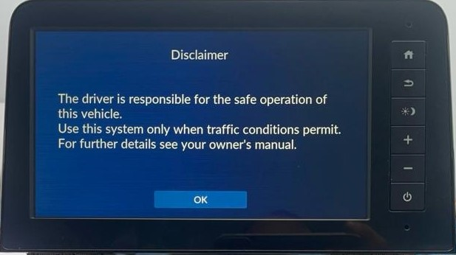
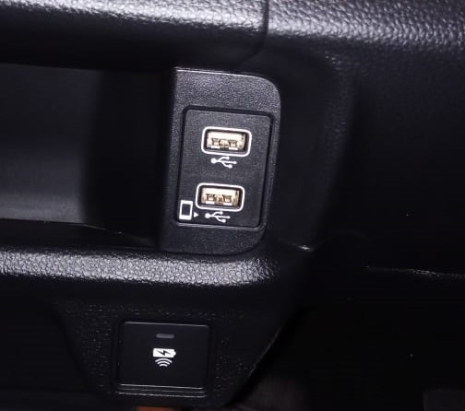
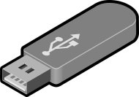
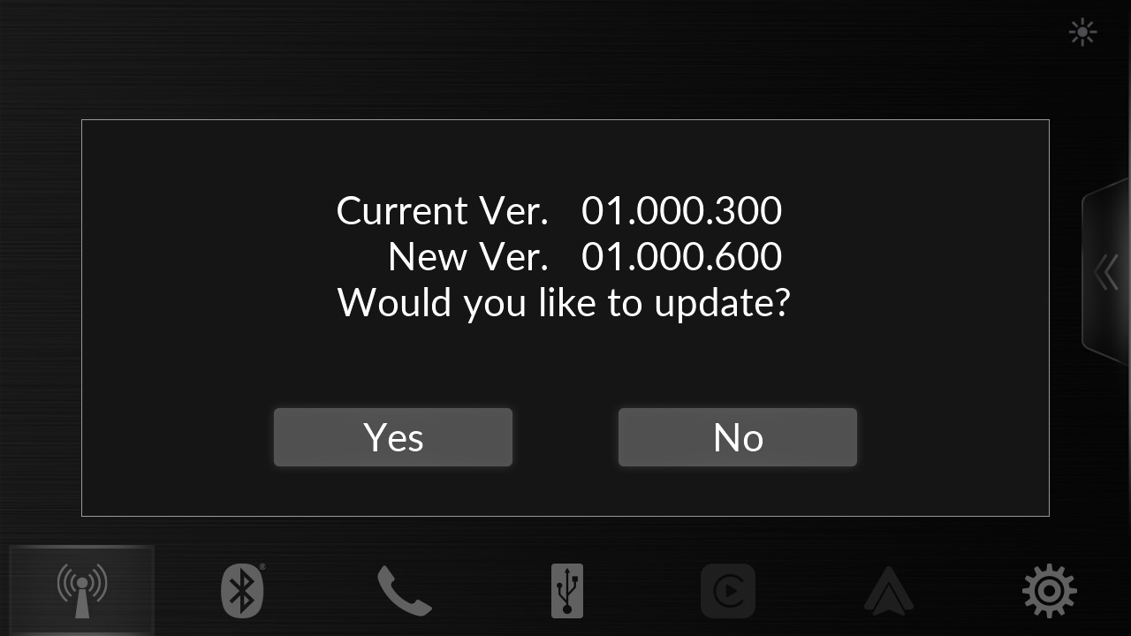
ANNEXURE- 4
Title : Software Update procedure
Please do not cut off power supply during boot upgrading,
otherwise, the H/U may be damaged and cannot be repaired.
No. | Description | Details
1 | Switch on the ignition
2 | Caution screen will appear. Select “OK”.
3 | Insert USB in port as shown in fig
4 | Pop will appear for software update. Select “Yes” .

Slide 7
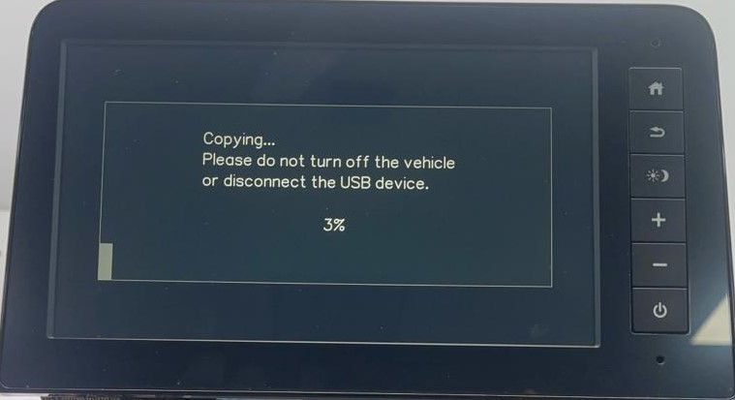
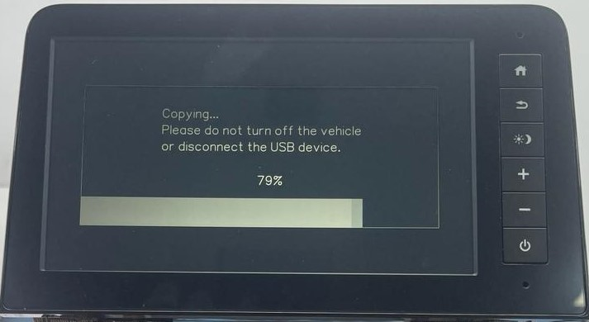
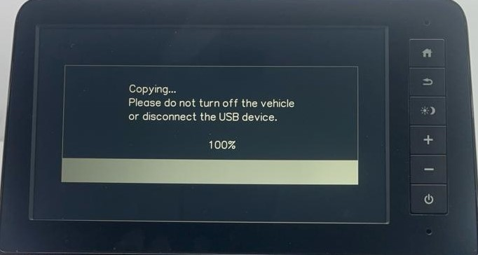
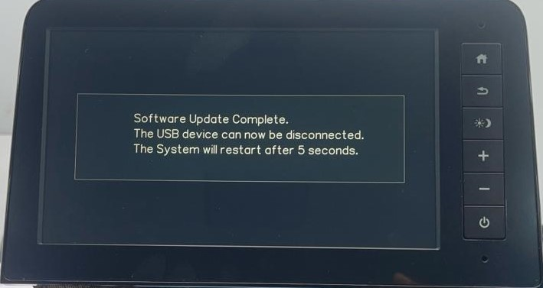
ANNEXURE- 4
Title : Software Update procedure
No. | Description | Details
5 | Software update will start. Audio Unit will reboot during the process. “Software Update Compete. The USB device can now be disconnected. The System will restart after 5 seconds” message will appear.

Slide 8
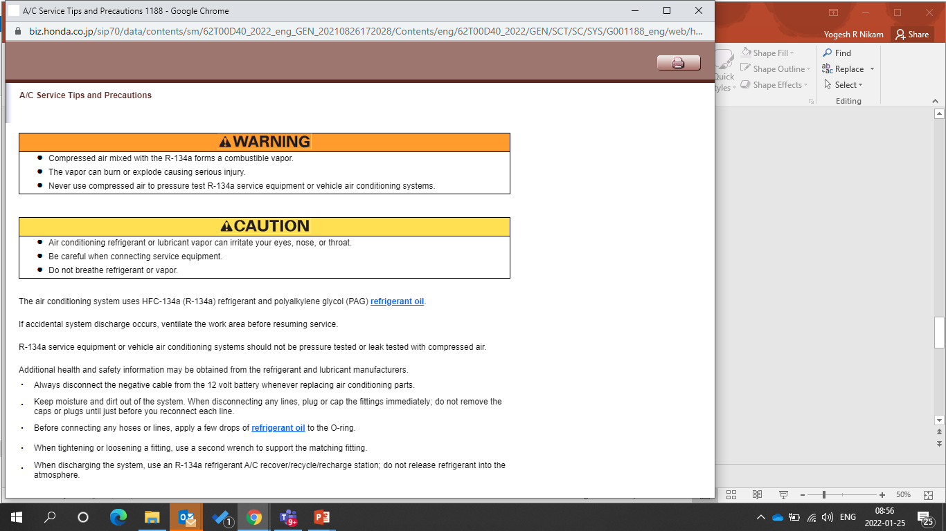
ANNEXURE- 4
Title : Software Update procedure
No. | Description | Details
6 | Switch off the vehicle
7 | Remove USB device from port
1. In case of fail during update. Please turn off ACC around 15 sec. and retry in first step again.

